Slide 1
MITS6100G Attack & Defense Evil Twin Attack Project Group - 05: 1. Resalat Amin - 100795080 Submitted to: Dr. Ruba Al Omari 2. Rifat Arefin Badhon - 100786251 3. Samin Yasar - 100796755

Slide 2
Introduction
Evil twin attack is a fake network that appears legitimate but its setup to eavesdrop and steal victim’s credentials
Victims are careless and impatient users
Hotspots of such attacks are the public spaces such as libraries, coffee shop etc. which provides free Wi-Fi
Victims are often lured to phishing sites where they often provide sensitive credentials

Slide 3
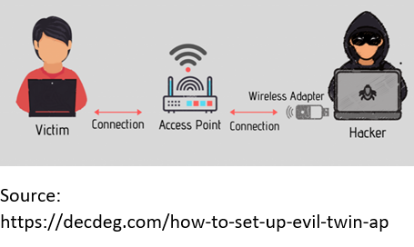
Attack Approach
In order to pull of an evil twin attack, an adversary needs to follow a few steps:
Step 1: setting up a fake access point
Attacker choses a popular spot with many network having the same name
Hacker notes the SSID
Using tools such as tablet, laptop, network card, attacker sets up a fake network
Victims cannot distinguish fake malicious network

Slide 4
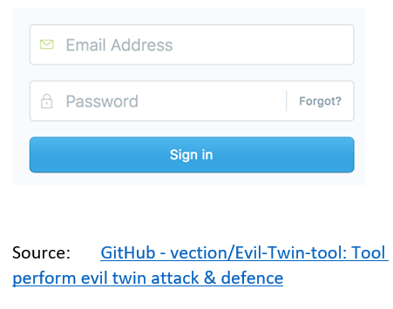
Attack Approach Cont.
Step 2: Setting up fake portal
public Wi-Fi networks require filling in data to a generic login page, a hacker takes advantage of this and sets up an exact copy of such page
This is done to steal victim's credentials

Slide 5
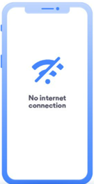
Attack Approach Cont.
Step 3: Making victims to connect to evil twin Wi-Fi
Hackers force users to disconnect to legitimate network and connect to evil
Twin network which has stronger signal
Hacker does this by taking over legitimate Wi-Fi network and kicking off
User from the network
Source:
https://nordvpn.com/blog/evil-twin-attack

Slide 6

Attack Approach Cont.
Step 4: Stealing sensitive information
Any user connected to the attacker's network fall victim
Hacker can monitor user activity
Attacker can see important credentials from victims and use them later to their benefit
Souce: https://www.smallbizdaily.com/4-common-ways-hackers-steal-your-customers-credit-card-data

Slide 7
Environment Setup
Equipment:
Wireless Adapter
Ethernet Connection
Software:
VMWare or VirtualBox
Kali Linux

Slide 8
Defensive Mechanisms Cont.
Use VPN before connecting with public Wi-Fi :
using a virtual private network encrypts data when it moves between a device and the network, leaving hacker unable to interpret data even if they can access it.
Never turn auto saves and do it manually:
often a device would auto connect to a network that has been used previously as credential to the network has been saved, being mindful about such case may help avoid malicious network.
Two factor Authentication :
Even if hacker gets the sensitive login details, they will not be able to log into the accounts.

Slide 9
Defensive Mechanisms
Self precaution:
try avoiding the use of sensitive websites such as banking websites while on public network. Watching out for what type of network you are being connected to may safeguard you to some extent. If you see two networks with similar SSID be on high alert as one of them might be a malicious network.

Slide 10
Conclusion
One of the most common attack is Evil Twin Attack
Should avoid public Wi-Fi
Without secure connection in browser, user should not enter their information
Public awareness is the best way to reduce this attack.

Slide 11
Presentation Video YouTube Link: https://youtu.be/86Cgu8UUEjA

